Slide 1
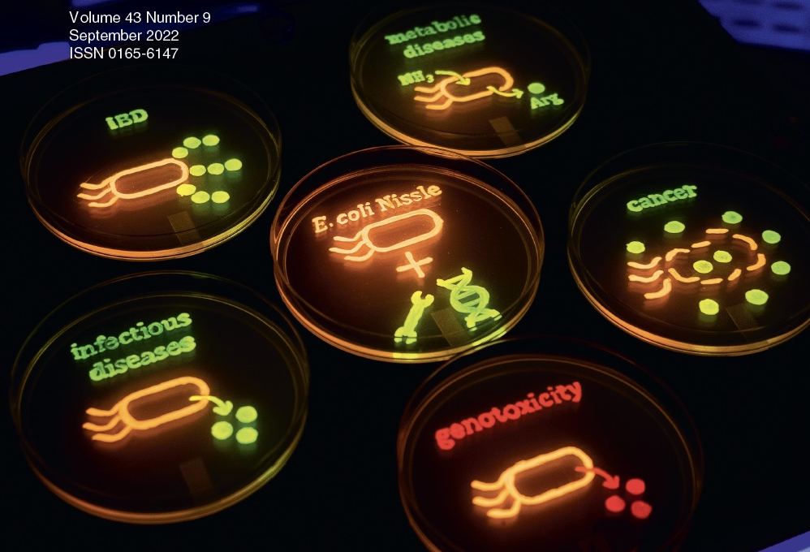
PROT₃EcT: Engineered Smart Microbes for the Targeted Delivery of High Precision Therapeutics to Sites of Disease
Cammie Lesser
Tufts University
School of Medicine

Slide 2
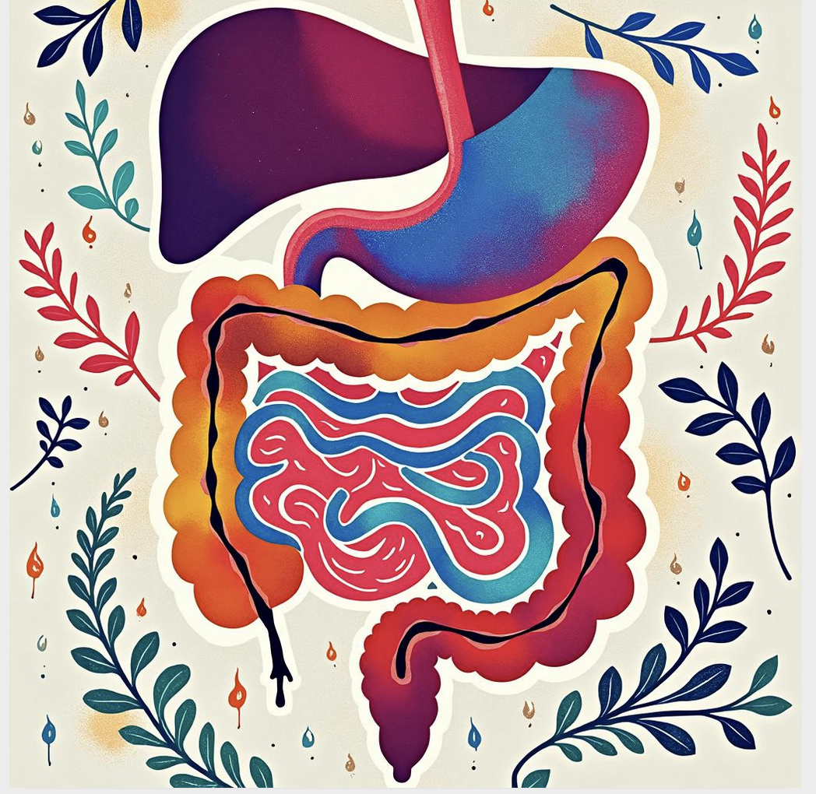
2-3 million IBD patients in US
40-50% with moderate to severe disease
$50-100K/yr for biologics

Slide 3
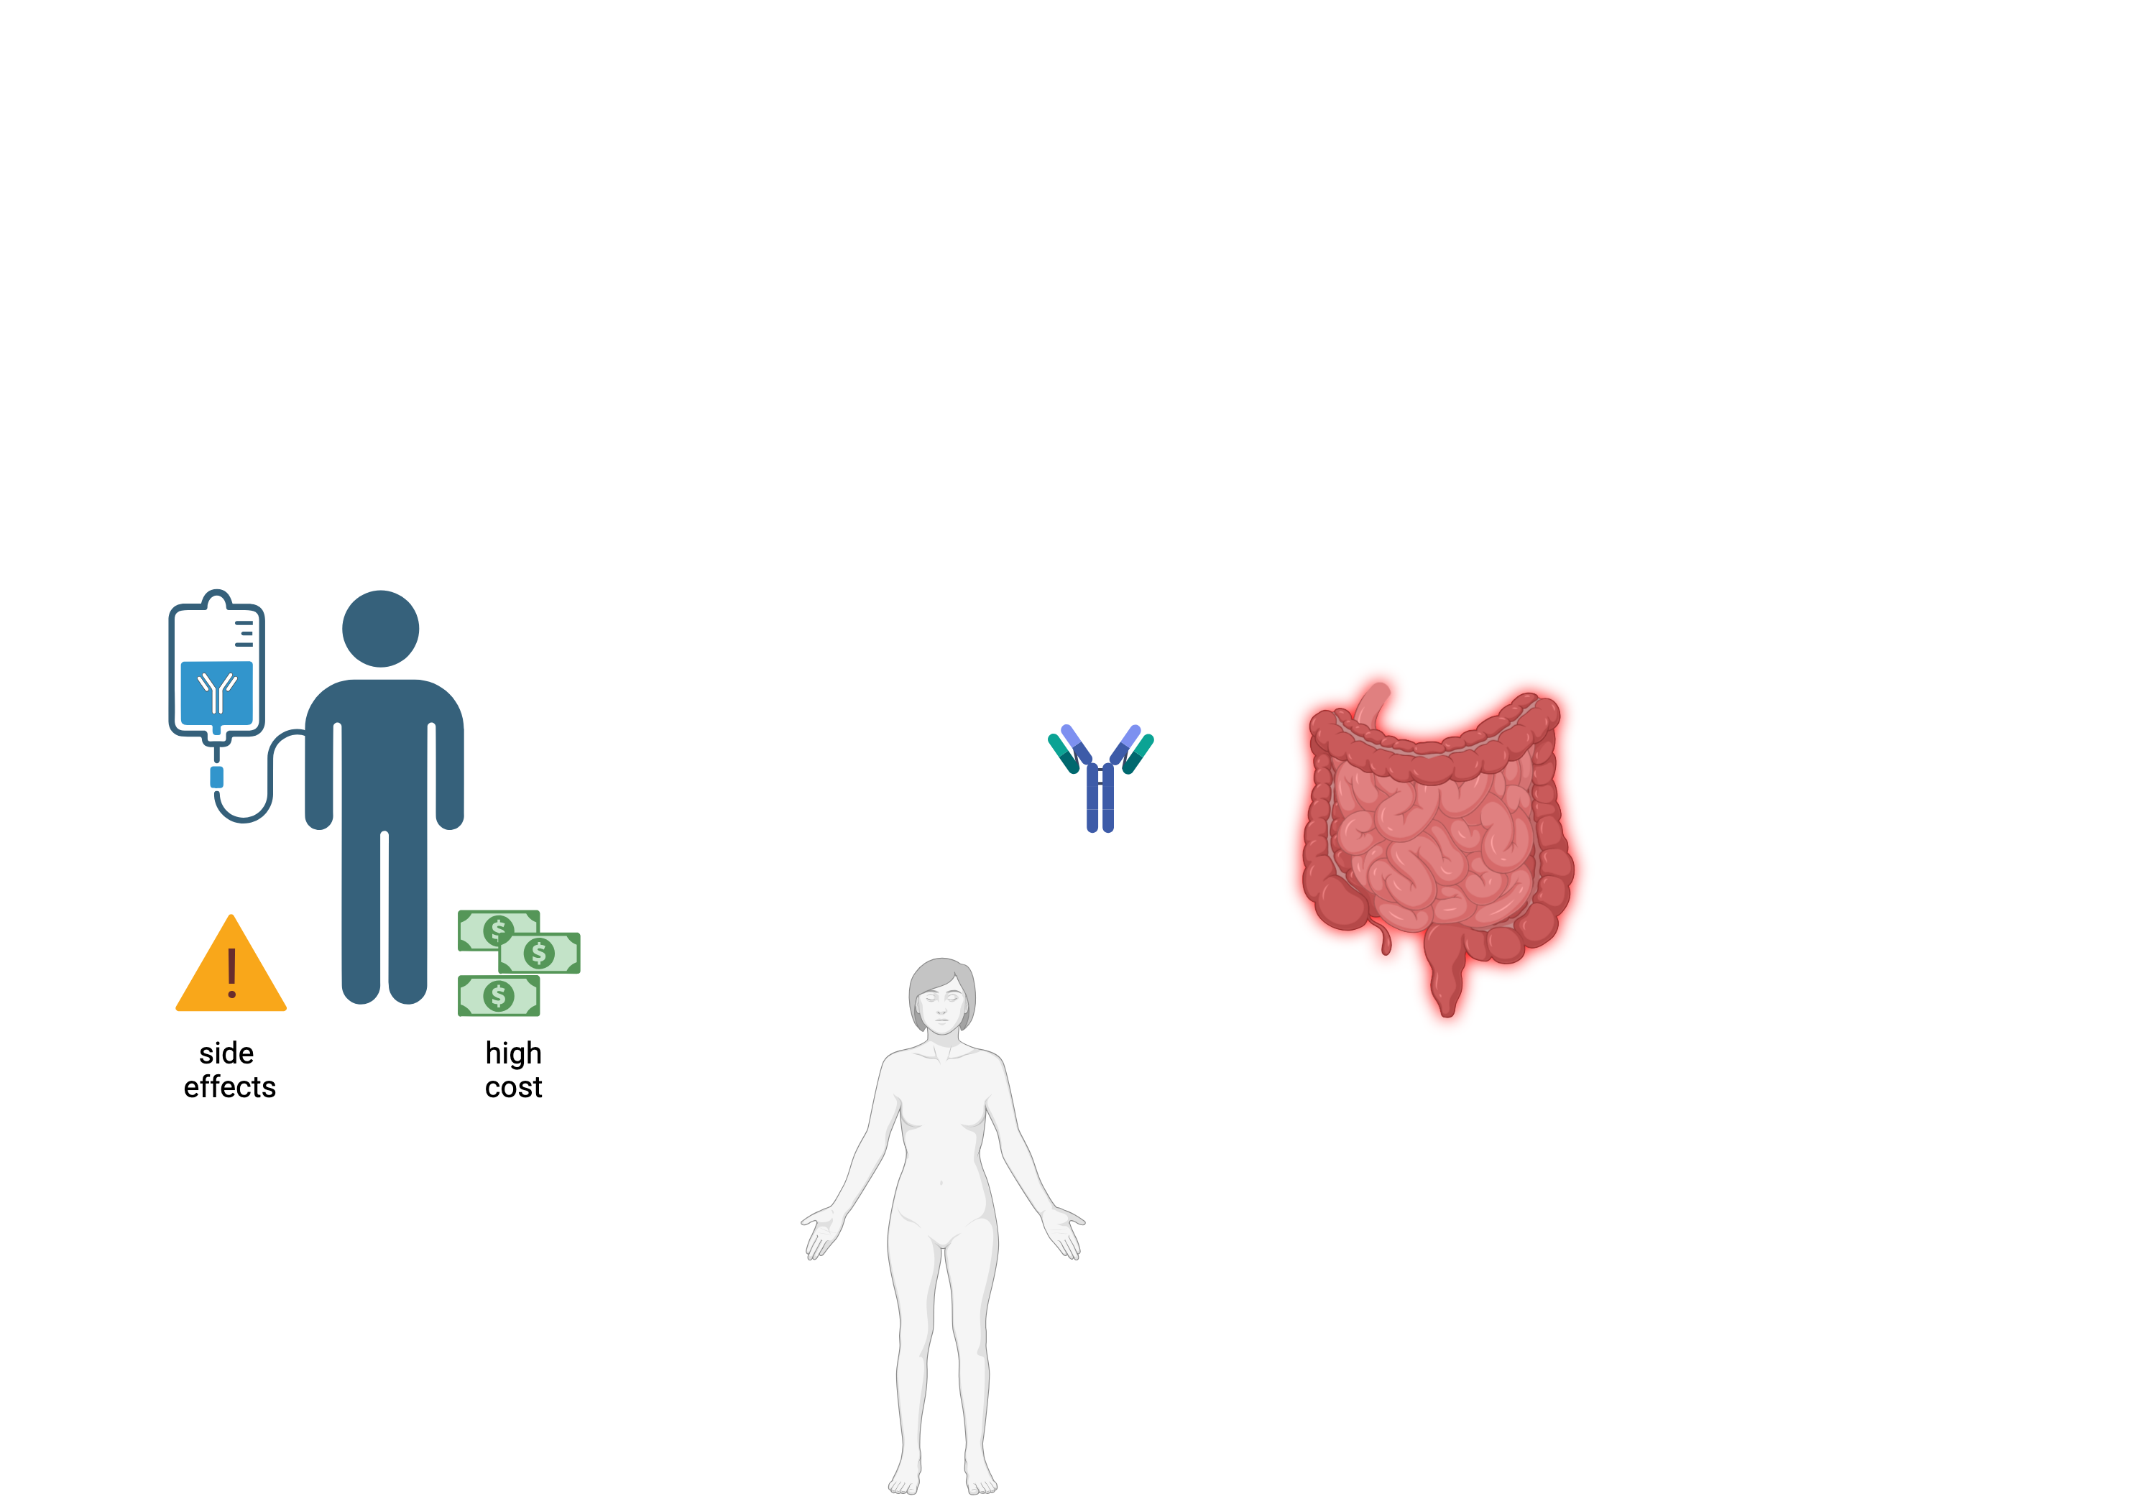
CHALLENGE
Why Current Approaches Fall Short
Systemic delivery
➔ side effects
Local disease
➔ unmet need

Slide 4
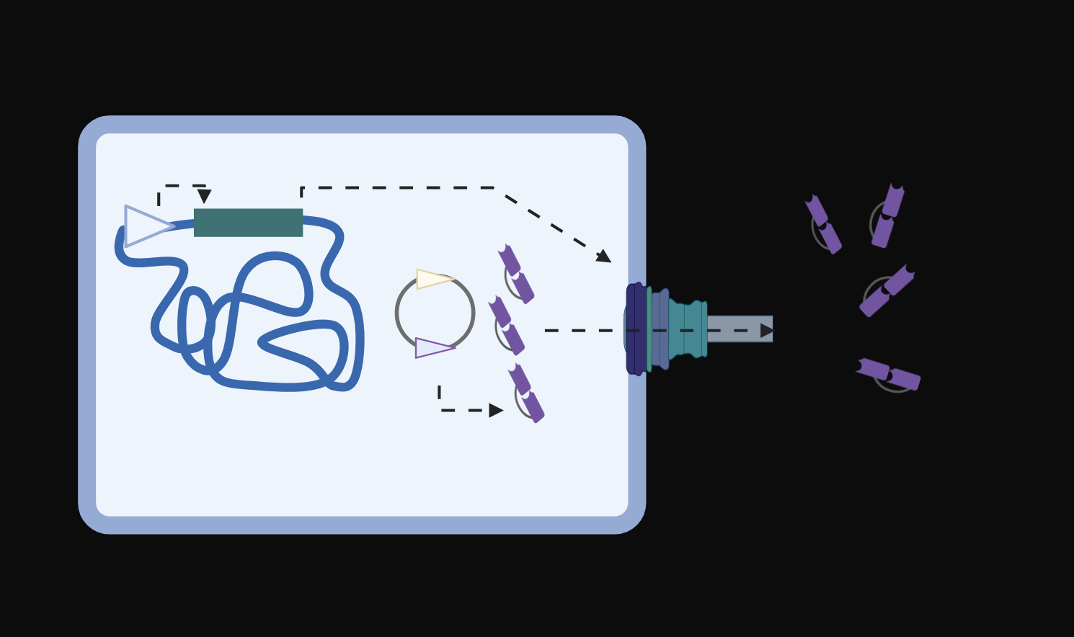
INNOVATION
PROT₃EcT: Smart Microbes for the Targeted Delivery of High Precision Therapeutics
PROT₃EcT

Slide 5
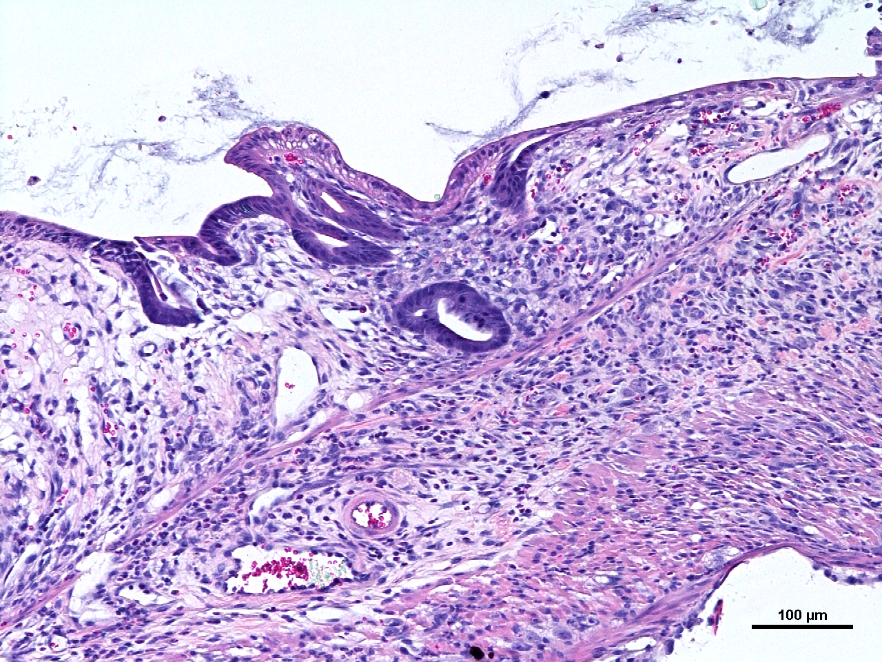
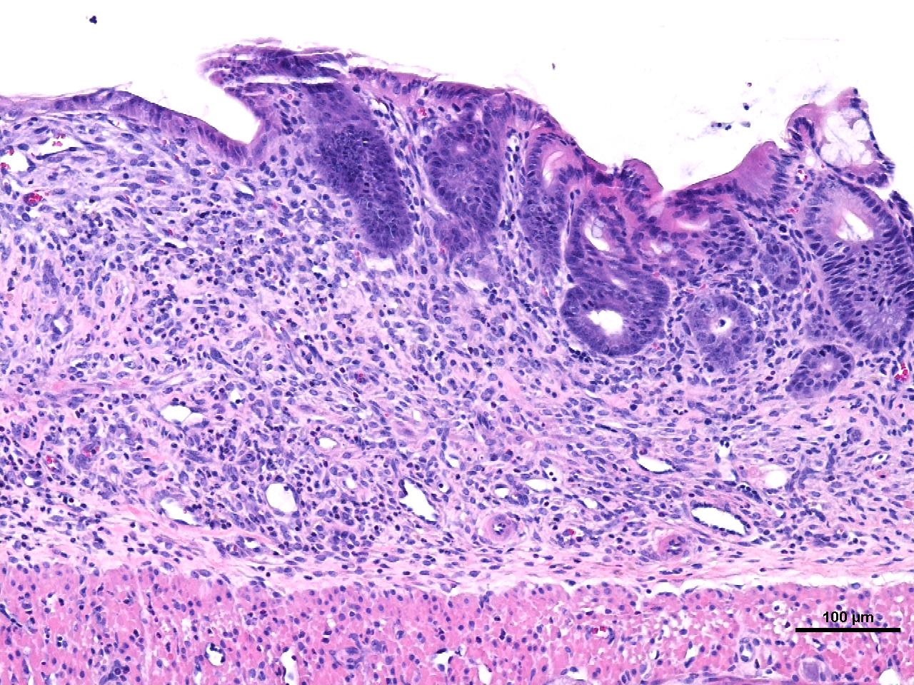
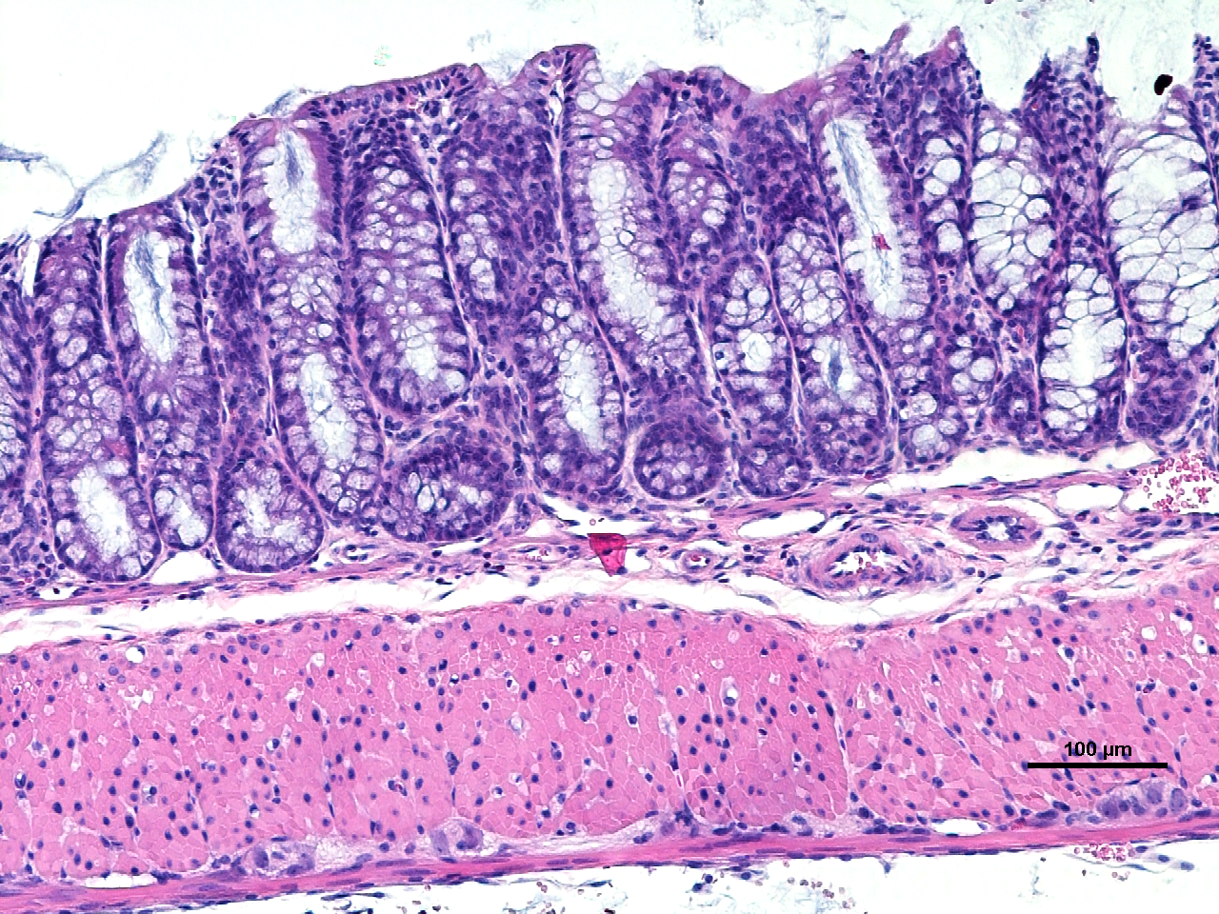
PROOF OF CONCEPT
PBS
PROT₃ECT
TNF-PROT₃ECT

Slide 6

IMPACT
IBD ➔ gut infections ➔ other gut-based diseases

Slide 7
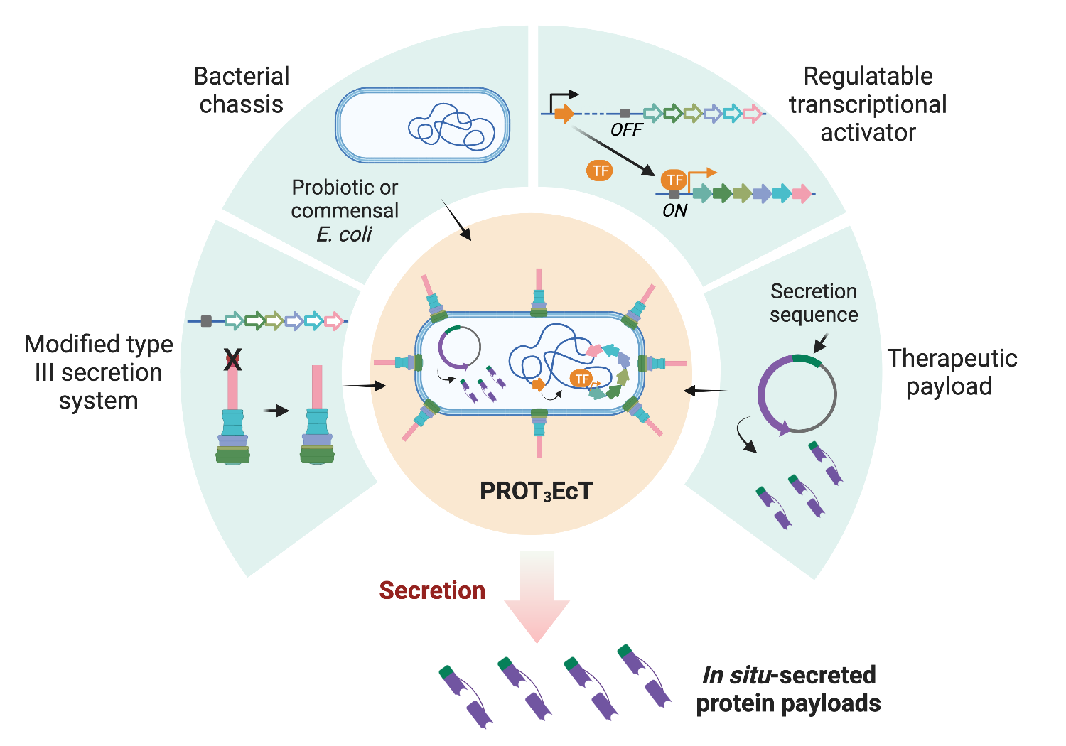
MODULAR PLATFORM TECHNOLOY

